Slide 1
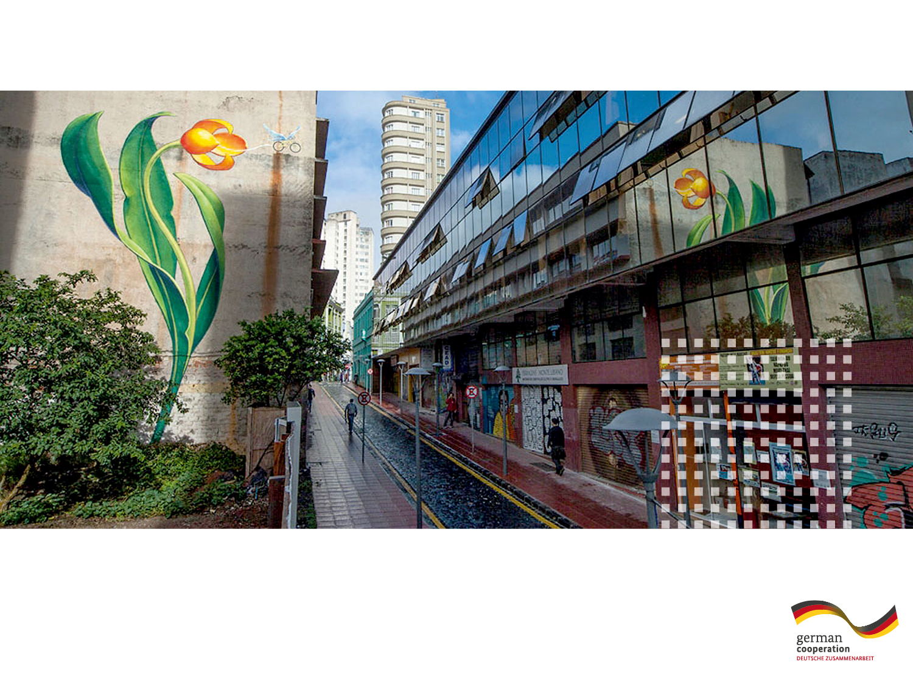


TECHNICAL
COOPERATION
Latin America
and the Caribbean
Promoting Innovation in the Green Economy
by including Quality Infrastructure
In Latin America and the Caribbean

Slide 2






Project Data
Project Goal The conditions for the development of the Green Economy are improved by including new and enhanced QI services
Regional scope Latin America and the Caribbean
Term 2016 – 2018
PTB Project Project coordinator Project assistant
Team Anna Kruip Karolin Stams
anna.kruip@ptb.de karolin.stams@ptb.de
Consultants
Andrea San Gil Ulrich Harmes-Liedtke sangilandrea@gmail.com uhl@mesopartner.com
Advisory
Committee

Slide 3
Project Outputs and Outcome
Lobbying and
Awareness raising
  Baseline Study
  National Workshops
  Capacity Building
  Consultancy
  Case Studies
New or enhanced QI services relevant for the Green Economy
  Dialogue Events
  QI aspects in political initiatives
Needs Assessment & Identification of thematic areas
Supporting the development of QI services in Pilots
Notes:
Grey: Project Activities/Outputs
Blue: Action lines
Green: Outcome Objectives

Slide 4
Thematic areas
Sustainable social housing
Sustainable Public Procurement
Green Economy
Efficient resource use
Inclusive
Low carbon
Electronic Waste
Life Cycle Assessment
Hazardous Waste
(in Labs)
Air qualiy monitoring
RE & Energy Efficiency
Water management
Climate Change & Biodiversity
Notes:
Mention UNDP definition and then suggested subjects that can be linked to the concept

Slide 5






Road Map
6) Pilot Projects
5) Selection of Pilots by Advisory Committee
4) Further development of thematic areas
3) Declaration of Interest by Qi bodies
2) Regional planning workshop
1) Needs assessment
Feb 16 – Sep 16
Aug 16
Oct 16 – Dec 16
Dec 16 – Mar 17
Apr 17
Jul 17 – XX/18

